Slide 1
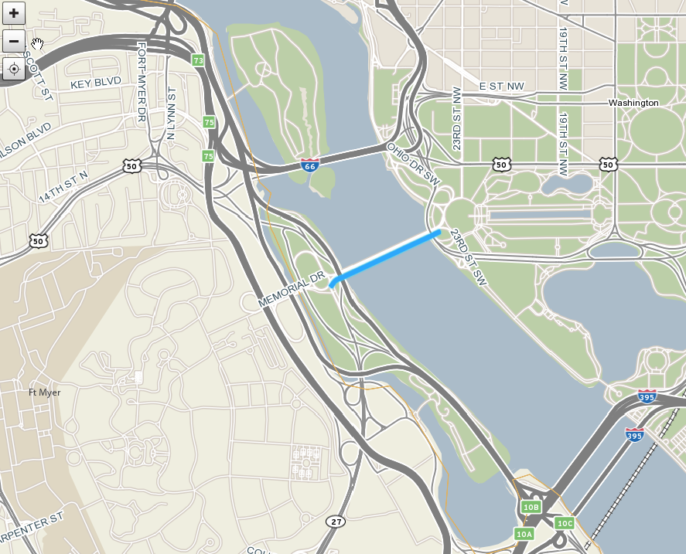
110+05757
Notes:
Memorial Bridge, Eastbound (Inbound)

Slide 2
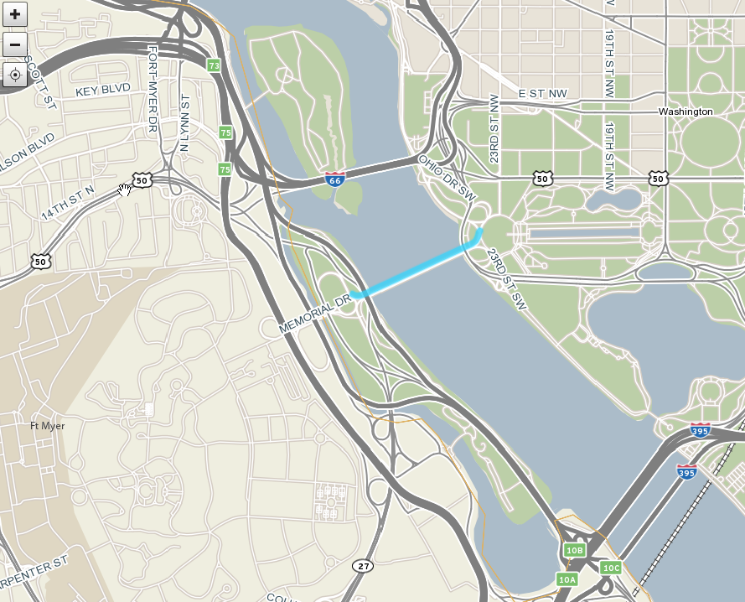
110-05756
Notes:
Memorial Bridge, Westbound (Outbound)

Slide 3
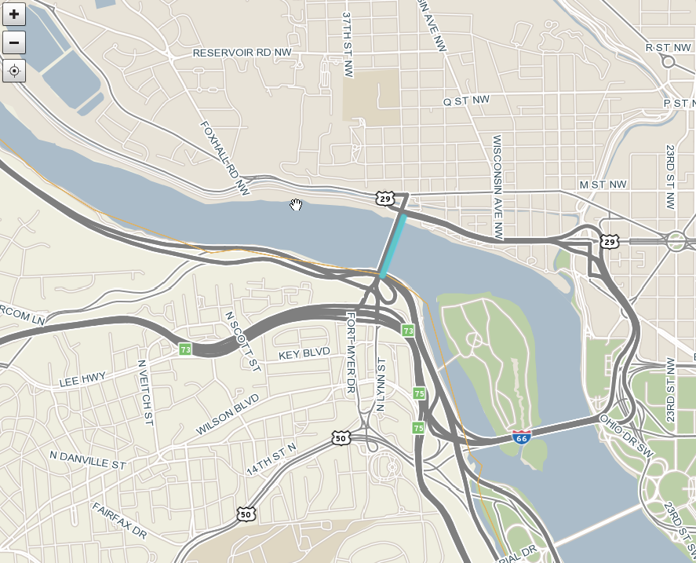
110+05755
Notes:
Key Bridge, Northbound (Inbound)

Slide 4
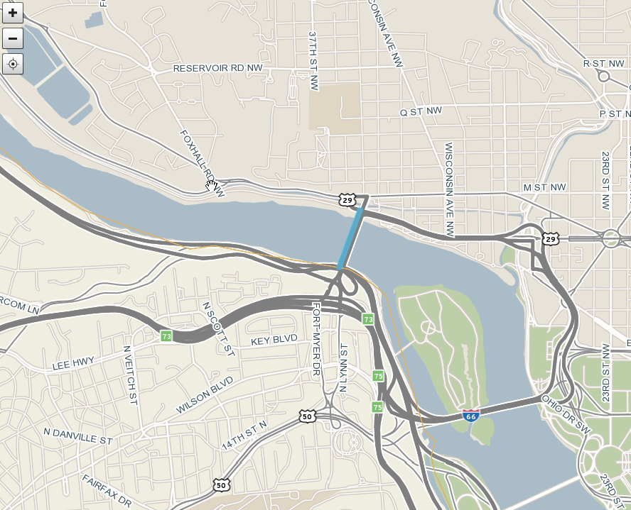
110-05754
Notes:
Key Bridge, Southbound (Outbound)

Slide 5
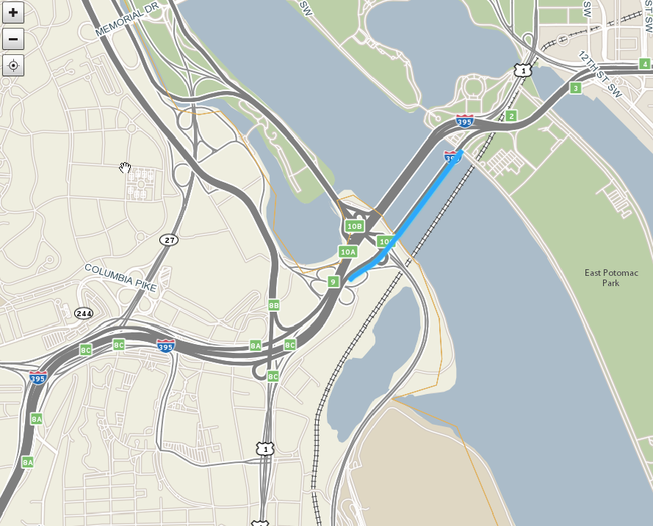
110P04131
110+04131
110P04130
110+04130
Notes:
14th Street Bridge, I-395, Northbound (Inbound)

Slide 6
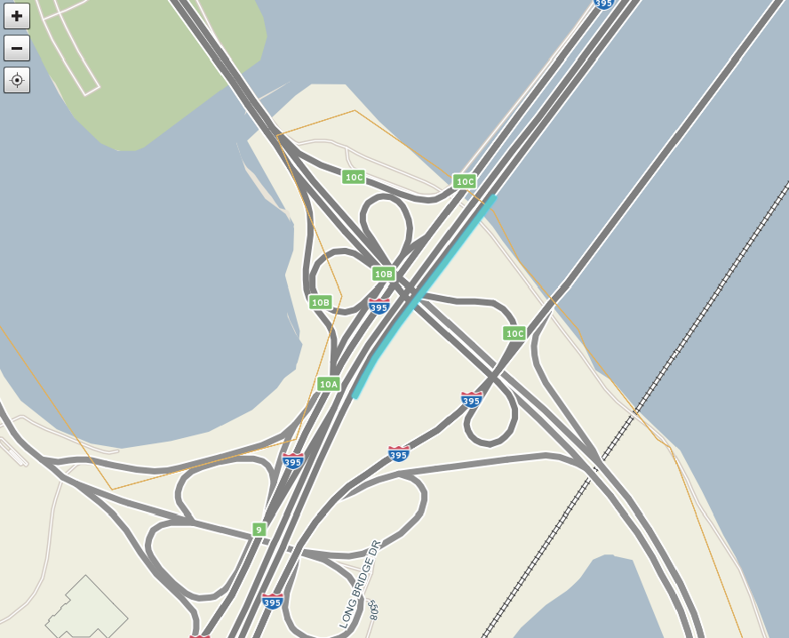
110+04303
Notes:
14th St Bridge, I-395 HOV, Northbound (Inbound)

Slide 7
Notes:
Missing 14th_HOV Inbound 110P04302

Slide 8
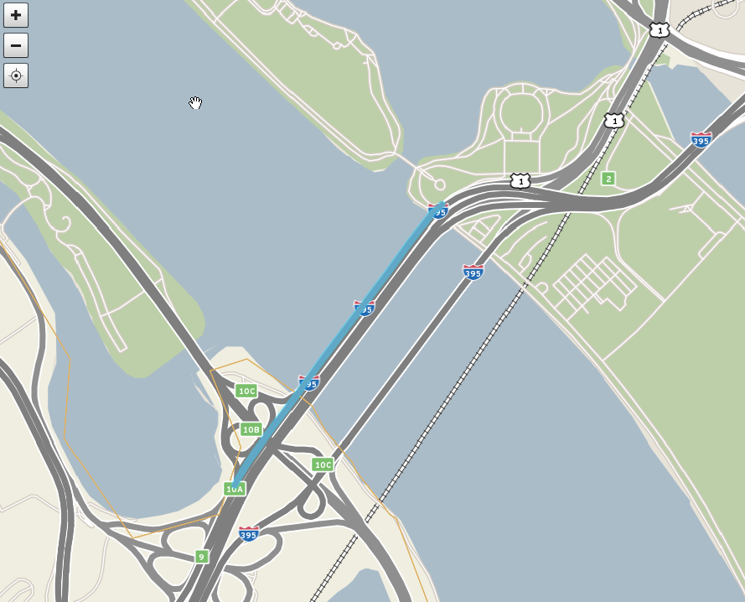
110N04131
110-04131
110N04130
110-04130
Notes:
14th Street Bridge, I-395, Southbound (Outbound)

Slide 9
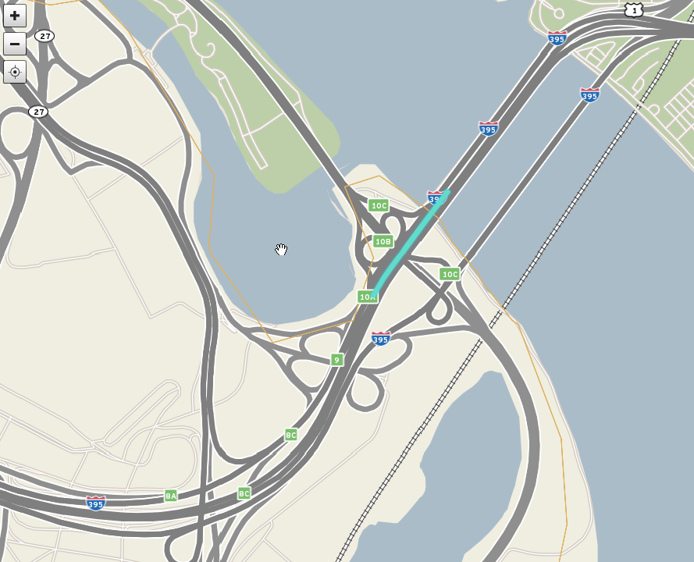
110N04302
110-04302
Notes:
14th Street Bridge, I-395 HOV, Southbound (Outbound)

Slide 10
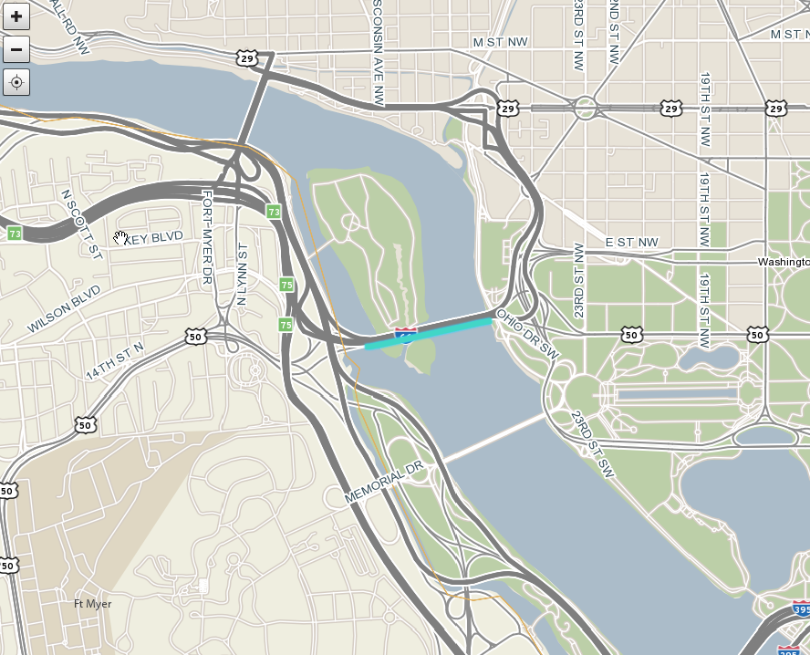
110N04161
110-04161
Notes:
Roosevelt Bridge, I-66, Eastbound (Inbound)

Slide 11
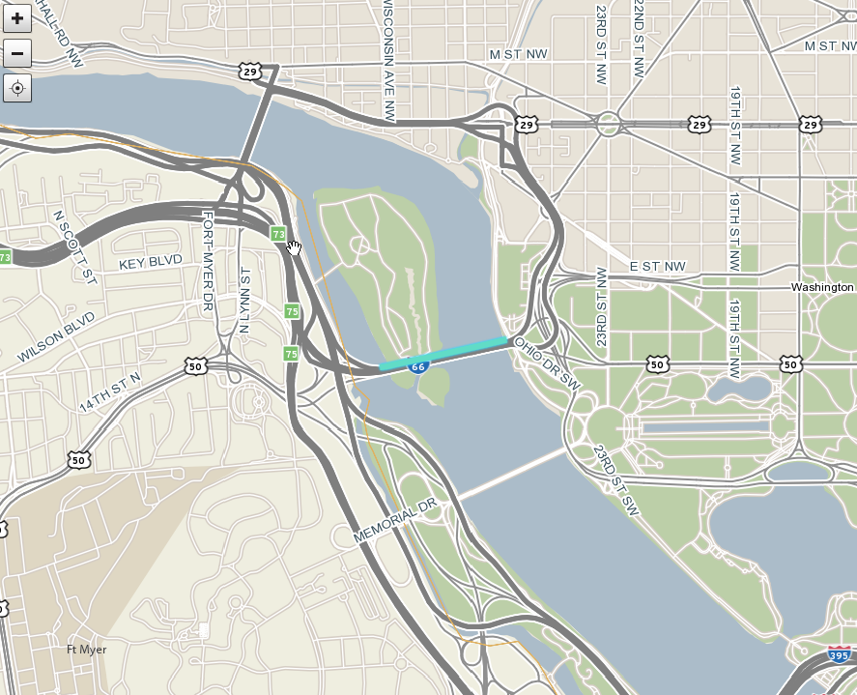
110P04161
110+04162
Notes:
Roosevelt Bridge, I-66, Westbound (Outbound)

Slide 12
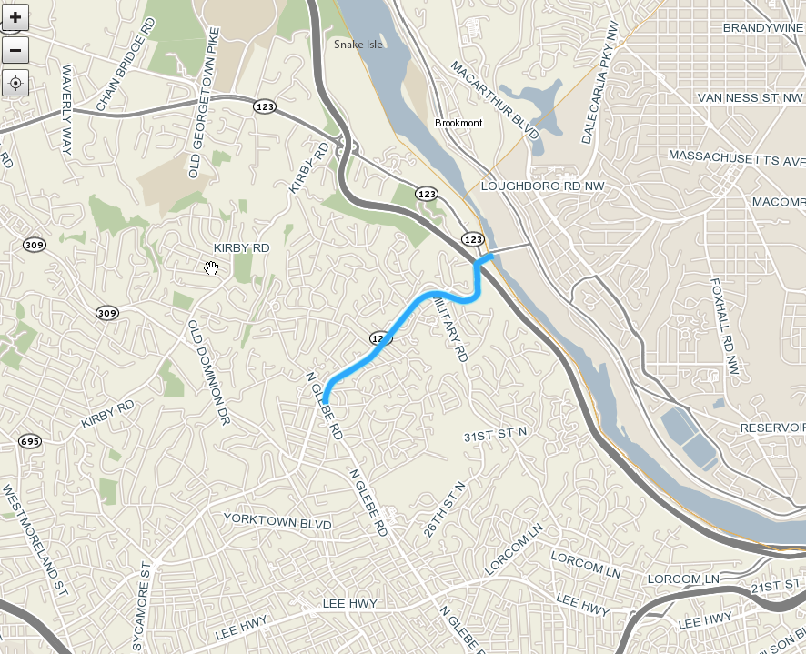
110+10237
110+10238
Notes:
Chain Bridge, VA approach

Slide 13
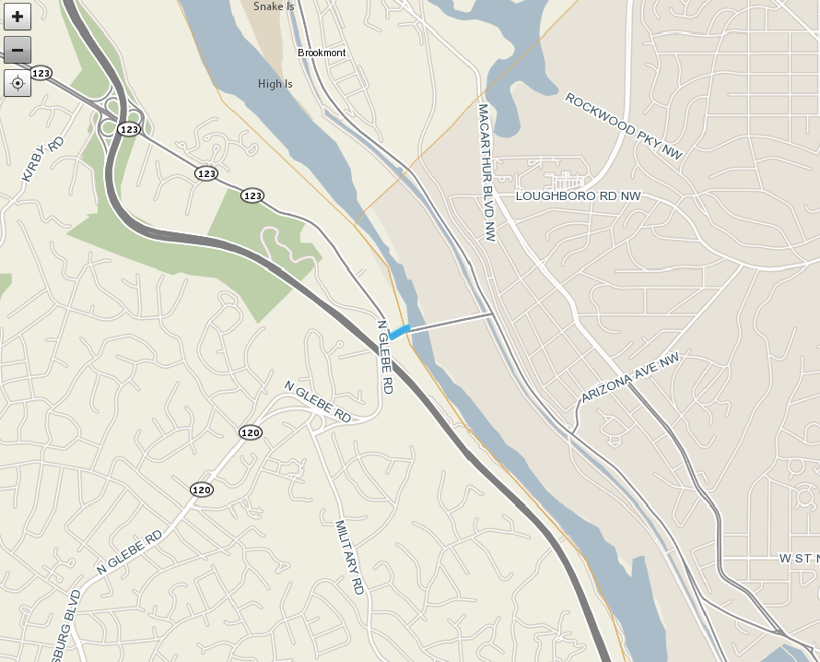
110-10237
Notes:
Chain Bridge, VA outbound

Slide 14
Notes:
still missing? 110-10238 VA-120 NORTHBOUND VA--DC STATE BORDER

